Slide 1







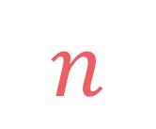

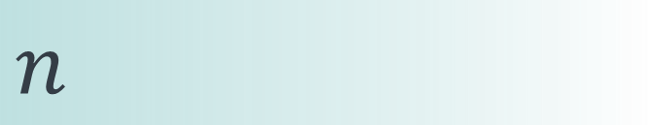

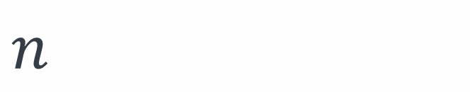
left
[4, 5, 1, 7, 2, 6, 3, 8]
no margin
Space complexity:
$$O(n)$$
list
list
list
list
mid
no margin
"string"
4 | 5 | 1 | 7 | 2 | 6 | 3 | 8
Space complexity:
$$O(n)$$
5
5
$
5
rec(n)
$$n$$
5
$$n$$
$$⇒$$
$$n$$
Time complexity:
$$O(n)$$
text
text
 |  |  | a
$$n$$
text
text
no margin
no margin
no margin
no margin
no margin
no margin
no margin
no margin

Slide 2

Longest increasing subsequence

Slide 3

$$\left|arr\right|≥1$$
Given an array arr, find the length of the longest subsequence where elements are strictly increasing

Slide 4

input:
arr = [7, 5, 2, 4, 7, 2, 3, 6, 4, 5, 12, 1, 7]
output: 5
explanation: A possible longest increasing subsequence is [2, 3, 4, 5, 12]
$$5$$
7
5
2
4
7
2
3
6
4
5
12
1
7

Slide 5

Subset
sum

Slide 6
subsets(k, i)
subsets
(k-arr[i], i+1)
subsets(k, i+1)

Slide 7
def subsets(arr, k, i=0): if k == 0: return 1 elif i == len(arr) or k < 0: return 0 else: return subsets(arr, k-arr[i], i+1) + subsets(arr, k, i+1)

Slide 8


Slide 9


Slide 10
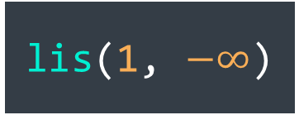
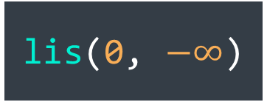
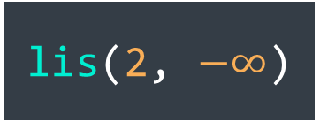
input:
arr = [7, 5, 2, 4, 7, 2, 3, 6, 4, 5, 12, 1, 7]
i
prev
lis(0, $−∞$)
lis(1, 7)
lis(1, $−∞$)
lis(2, 7)
lis(2, 5)
lis(2, $−∞$)
.
.
.
.
.
.
.
.
.

Slide 11

$$lis\left(i, prev\right)=max⁡(1+lis\left(i+1, arr\left[i\right]\right),$$
$lis\left(i+1, prev\right))$

Slide 12

$$i=\left|arr\right|→0$$

Slide 13







$$0$$
$$if i=|arr|$$
$$lis\left(i, prev\right)=$$
$$lis\left(i+1, prev\right)$$
$$if arr\left[i\right]≤prev$$
$$max⁡(1+lis\left(i+1, arr\left[i\right]\right),$$
$$lis\left(i+1, prev\right))$$
$$otherwise$$

Slide 14







def lis(arr, i=0, prev=float("-inf")): if i == len(arr): return 0 elif arr[i] <= prev: return lis(arr, i+1, prev) else: return max(1+lis(arr, i+1, arr[i]),
lis(arr, i+1, prev))
$$0$$
$$if i=|arr|$$
$$lis\left(i, prev\right)=$$
$$lis\left(i+1, prev\right)$$
$$if arr\left[i\right]≤prev$$
$$max⁡(1+lis\left(i+1, arr\left[i\right]\right),$$
$$lis\left(i+1, prev\right))$$
$$otherwise$$

Slide 15
def lis(arr, i=0, prev=float("-inf")): if i == len(arr): return 0 elif arr[i] <= prev: return lis(arr, i+1, prev) else: return max(1+lis(arr, i+1, arr[i]),
lis(arr, i+1, prev))
$$0$$
$$if i=|arr|$$
$$lis\left(i, prev\right)=$$
$$lis\left(i+1, prev\right)$$
$$if arr\left[i\right]≤prev$$
$$max⁡(1+lis\left(i+1, arr\left[i\right]\right),$$
$$lis\left(i+1, prev\right))$$
$$otherwise$$

Slide 16
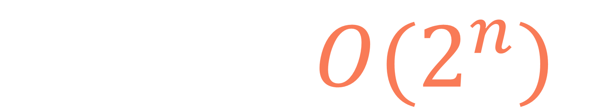
def lis(arr, i=0, prev=float("-inf")): if i == len(arr): return 0 elif arr[i] <= prev: return lis(arr, i+1, prev) else: return max(1+lis(arr, i+1, arr[i]),
lis(arr, i+1, prev))
$$T\left(n\right)=O(2^{n})$$

Slide 17

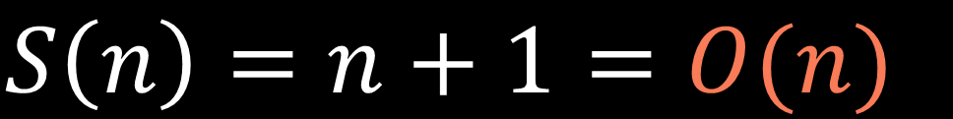
lis(n,prev)
.
.
.
$$S\left(n\right)=n+1=O(n)$$
lis(2,prev)
$$n+1$$
lis(1,prev)
lis(0,prev)

Slide 18
input:
arr = [7, 5, 2, 4, 7, 2, 3, 6, 4, 5, 12, 1, 7]
lis(arr)
0
1
2
3
4
5
6
7
8
9
10
11
12

Slide 19
input:
arr = [7, 5, 2, 4, 7, 2, 3, 6, 4, 5, 12, 1, 7]
lis(arr)
0
1
2
3
4
5
6
7
8
9
10
11
12
rec(0)

Slide 20
input:
arr = [7, 5, 2, 4, 7, 2, 3, 6, 4, 5, 12, 1, 7]
lis(arr)
0
1
2
3
4
5
6
7
8
9
10
11
12
rec(0)
rec(10)

Slide 21
input:
arr = [7, 5, 2, 4, 7, 2, 3, 6, 4, 5, 12, 1, 7]
lis(arr)
0
1
2
3
4
5
6
7
8
9
10
11
12
rec(0)
1
rec(10)

Slide 22
input:
arr = [7, 5, 2, 4, 7, 2, 3, 6, 4, 5, 12, 1, 7]
lis(arr)
0
1
2
3
4
5
6
7
8
9
10
11
12
2
rec(0)
1
rec(10)

Slide 23
input:
arr = [7, 5, 2, 4, 7, 2, 3, 6, 4, 5, 12, 1, 7]
lis(arr)
0
1
2
3
4
5
6
7
8
9
10
11
12
2
rec(0)
rec(1)
1
rec(10)

Slide 24
input:
arr = [7, 5, 2, 4, 7, 2, 3, 6, 4, 5, 12, 1, 7]
lis(arr)
0
1
2
3
4
5
6
7
8
9
10
11
12
2
rec(0)
rec(1)
1
rec(10)
rec(4)

Slide 25
input:
arr = [7, 5, 2, 4, 7, 2, 3, 6, 4, 5, 12, 1, 7]
lis(arr)
0
1
2
3
4
5
6
7
8
9
10
11
12
2
rec(0)
rec(1)
1
rec(10)
rec(4)
rec(10)

Slide 26
input:
arr = [7, 5, 2, 4, 7, 2, 3, 6, 4, 5, 12, 1, 7]
lis(arr)
0
1
2
3
4
5
6
7
8
9
10
11
12
2
rec(0)
rec(1)
1
rec(10)
rec(4)
1
rec(10)

Slide 27
input:
arr = [7, 5, 2, 4, 7, 2, 3, 6, 4, 5, 12, 1, 7]
lis(arr)
0
1
2
3
4
5
6
7
8
9
10
11
12
2
rec(0)
rec(1)
1
2
rec(10)
rec(4)
1
rec(10)

Slide 28
input:
arr = [7, 5, 2, 4, 7, 2, 3, 6, 4, 5, 12, 1, 7]
lis(arr)
0
1
2
3
4
5
6
7
8
9
10
11
12
2
rec(0)
rec(1)
1
2
rec(10)
rec(4)
rec(7)
1
rec(10)

Slide 29
input:
arr = [7, 5, 2, 4, 7, 2, 3, 6, 4, 5, 12, 1, 7]
lis(arr)
0
1
2
3
4
5
6
7
8
9
10
11
12
2
rec(0)
rec(1)
1
2
rec(10)
rec(4)
rec(7)
1
rec(10)
rec(10)

Slide 30
input:
arr = [7, 5, 2, 4, 7, 2, 3, 6, 4, 5, 12, 1, 7]
lis(arr)
0
1
2
3
4
5
6
7
8
9
10
11
12
2
rec(0)
rec(1)
1
2
rec(10)
rec(4)
rec(7)
1
1
rec(10)
rec(10)

Slide 31
input:
arr = [7, 5, 2, 4, 7, 2, 3, 6, 4, 5, 12, 1, 7]
lis(arr)
0
1
2
3
4
5
6
7
8
9
10
11
12
2
rec(0)
rec(1)
1
2
rec(10)
rec(4)
rec(7)
1
1
rec(10)
rec(10)
rec(12)

Slide 32
input:
arr = [7, 5, 2, 4, 7, 2, 3, 6, 4, 5, 12, 1, 7]
lis(arr)
0
1
2
3
4
5
6
7
8
9
10
11
12
2
rec(0)
rec(1)
1
2
rec(10)
rec(4)
rec(7)
1
1
1
rec(10)
rec(10)
rec(12)

Slide 33
input:
arr = [7, 5, 2, 4, 7, 2, 3, 6, 4, 5, 12, 1, 7]
lis(arr)
0
1
2
3
4
5
6
7
8
9
10
11
12
2
rec(0)
rec(1)
1
2
2
rec(10)
rec(4)
rec(7)
1
1
1
rec(10)
rec(10)
rec(12)

Slide 34
input:
arr = [7, 5, 2, 4, 7, 2, 3, 6, 4, 5, 12, 1, 7]
lis(arr)
0
1
2
3
4
5
6
7
8
9
10
11
12
2
rec(0)
rec(1)
1
2
2
rec(10)
rec(4)
rec(7)
rec(10)
1
1
1
rec(10)
rec(10)
rec(12)

Slide 35
input:
arr = [7, 5, 2, 4, 7, 2, 3, 6, 4, 5, 12, 1, 7]
lis(arr)
0
1
2
3
4
5
6
7
8
9
10
11
12
2
rec(0)
rec(1)
1
2
2
1
rec(10)
rec(4)
rec(7)
rec(10)
1
1
1
rec(10)
rec(10)
rec(12)

Slide 36
input:
arr = [7, 5, 2, 4, 7, 2, 3, 6, 4, 5, 12, 1, 7]
lis(arr)
0
1
2
3
4
5
6
7
8
9
10
11
12
2
rec(0)
rec(1)
1
2
2
1
rec(10)
rec(4)
rec(7)
rec(10)
rec(12)
1
1
1
rec(10)
rec(10)
rec(12)

Slide 37
input:
arr = [7, 5, 2, 4, 7, 2, 3, 6, 4, 5, 12, 1, 7]
lis(arr)
0
1
2
3
4
5
6
7
8
9
10
11
12
2
rec(0)
rec(1)
1
2
2
1
1
rec(10)
rec(4)
rec(7)
rec(10)
rec(12)
1
1
1
rec(10)
rec(10)
rec(12)

Slide 38
input:
arr = [7, 5, 2, 4, 7, 2, 3, 6, 4, 5, 12, 1, 7]
lis(arr)
0
1
2
3
4
5
6
7
8
9
10
11
12
2
3
rec(0)
rec(1)
1
2
2
1
1
rec(10)
rec(4)
rec(7)
rec(10)
rec(12)
1
1
1
rec(10)
rec(10)
rec(12)

Slide 39
input:
arr = [7, 5, 2, 4, 7, 2, 3, 6, 4, 5, 12, 1, 7]
lis(arr)
0
1
2
3
4
5
6
7
8
9
10
11
12
rec(0)
rec(1)
...
...
...
...
rec(10)
rec(4)
rec(7)
rec(10)
rec(12)
rec(10)
...
...
rec(10)
rec(12)

Slide 40


$$rec\left(i\right)=1+ \max_{aaaaaa}{rec(j)}$$
$$\begin{aligned}j∈\left[i+1,n\right), \\ arr\left[j\right]>arr[i] \\ a\end{aligned}$$

Slide 41




$$rec\left(i\right)=1+ \max_{aaaaaa}{rec(j)}$$
$$\begin{aligned}j∈\left[i+1,n\right), \\ arr\left[j\right]>arr[i] \\ a\end{aligned}$$
$$lis\left(arr\right)=\max{ rec(i)}$$
$$i∈[0, \left|arr\right|)$$

Slide 42




def lis(arr): def rec(arr, i): maxlen = 0 for j in range(i+1, len(arr)): if arr[j] > arr[i]: maxlen = max(maxlen, rec(arr, j)) return 1+maxlen return max([rec(arr, i) for i in range(len(arr))])
$$rec\left(i\right)=1+ \max_{aaaaaa}{rec(j)}$$
$$\begin{aligned}j∈\left[i+1,n\right), \\ arr\left[j\right]>arr[i] \\ a\end{aligned}$$
$$lis\left(arr\right)=\max{ rec(i)}$$
$$i∈[0, \left|arr\right|)$$

Slide 43
$$T\left(n\right)=T\left(n−1\right)+T\left(n−2\right)+…+T\left(0\right)+O(1)$$

Slide 44


$$T\left(n\right)=T\left(n−1\right)+T\left(n−2\right)+…+T\left(0\right)+O(1)$$
$$T\left(n−1\right)=T\left(n−2\right)+T\left(n−3\right)+…+T\left(0\right)+O(1)$$
$$T\left(n\right)=T\left(n−1\right)+T(n−1)+O(1)$$
$$T\left(n\right)=2T\left(n−1\right)+O(1)$$
$$T\left(n\right)=2\left(2T\left(n−2\right)+O\left(1\right)\right)+O\left(1\right) \\ T\left(n\right)=4T\left(n−2\right)+3∗O\left(1\right) \\ T\left(n\right)=4\left(2T\left(n−3\right)+O\left(1\right)\right)+3∗O\left(1\right) \\ T\left(n\right)=8T\left(n−3\right)+7∗O\left(1\right) \\ . \\ T\left(n\right)=2^{k}T\left(n−k\right)+\left(2^{k}−1\right)∗O\left(1\right) \\ . \\ T\left(n\right)=2^{n}T\left(n−n\right)+\left(2^{n}−1\right)∗O\left(1\right) \\ T\left(n\right)=2^{n}T\left(0\right)+\left(2^{n}−1\right)∗O\left(1\right) \\ T\left(n\right)=2^{n}+\left(2^{n}−1\right)∗O\left(1\right) \\ T\left(n\right)=O(2^{n})$$

Slide 45


$$T\left(n\right)=O(2^{n})$$
$$T_{2}\left(n\right)=T\left(n\right)+T\left(n−1\right)+T\left(n−2\right)+…+T(1)$$
$T\left(n\right):$ rec()
$T_{2}(n)$: lis()

Slide 46








$$T\left(n\right)=O(2^{n})$$
$$T_{2}\left(n\right)=T\left(n\right)+T\left(n−1\right)+T\left(n−2\right)+…+T(1)$$
$$T_{2}\left(n\right)=$$
$$2^{n}$$
$$+$$
$$2^{n−1}$$
$$+$$
$$2^{n−2}$$
$$+…+$$
$$2^{1}$$
$T\left(n\right):$ rec()
$T_{2}(n)$: lis()

Slide 47

$$T\left(n\right)=O(2^{n})$$
$$T_{2}\left(n\right)=T\left(n\right)+T\left(n−1\right)+T\left(n−2\right)+…+T(1)$$
$$T_{2}\left(n\right)=$$
$$2^{n}$$
$$+$$
$$2^{n−1}$$
$$+$$
$$2^{n−2}$$
$$+…+$$
$$2^{1}$$
$$T_{2}\left(n\right)=\sum_{k=0}^{n−1}{2^{n−k}}$$
$T\left(n\right):$ rec()
$T_{2}(n)$: lis()

Slide 48
$$T\left(n\right)=O(2^{n})$$
$$T_{2}\left(n\right)=T\left(n\right)+T\left(n−1\right)+T\left(n−2\right)+…+T(1)$$
$$T_{2}\left(n\right)=$$
$$2^{n}$$
$$+$$
$$2^{n−1}$$
$$+$$
$$2^{n−2}$$
$$+…+$$
$$2^{1}$$
$$T_{2}\left(n\right)=\sum_{k=0}^{n−1}{2^{n−k}}$$
$$T_{2}\left(n\right)=2∗2^{n}−2=O\left(2^{n}\right)$$
$T\left(n\right):$ rec()
$T_{2}(n)$: lis()

Slide 49
lis(n)
.
.
.
$$S\left(n\right)=n+1=O(n)$$
lis(2)
$$n+1$$
lis(1)
lis(0)

Slide 50
First solution:
def lis(arr, i=0, prev=float("-inf")): if i == len(arr): return 0 elif arr[i] <= prev: return lis(arr, i+1, prev) else: return max(1+lis(arr, i+1, arr[i]),
lis(arr, i+1, prev))
Second solution:
def lis(arr): def rec(arr, i): maxlen = 0 for j in range(i+1, len(arr)): if arr[j] > arr[i]: maxlen = max(maxlen, rec(arr, j)) return 1+maxlen return max([rec(arr, i) for i in range(len(arr))])

Slide 51
Second solution:
def lis(arr): def rec(arr, i): maxlen = 0 for j in range(i+1, len(arr)): if arr[j] > arr[i]: maxlen = max(maxlen, rec(arr, j)) return 1+maxlen return max([rec(arr, i) for i in range(len(arr))])

Slide 52
rec
(0)
rec
(1)
rec
(2)
rec
(3)
rec
(4)
rec
(5)
rec
(6)
rec
(7)
rec
(8)
rec
(9)
rec
(10)
rec
(11)
rec
(12)

Slide 53
rec
(0)
rec
(1)
rec
(2)
rec
(3)
rec
(4)
rec
(5)
rec
(6)
rec
(7)
rec
(8)
rec
(9)
rec
(10)
rec
(11)
rec
(12)

Slide 54
def lis(arr): def rec(arr, i, lookup=None): if i in lookup: return lookup[i] max_len = 0 for j in range(i+1, len(arr)): if arr[j] > arr[i]: max_len = max(max_len, rec(arr, j, lookup)) lookup[i] = 1+max_len return lookup[i] lookup = {} return max([rec(arr, i, lookup) for i in range(len(arr))])
1
3
4
2

Slide 55



def lis(arr): def rec(arr, i, lookup=None): if i in lookup: return lookup[i] max_len = 0 for j in range(i+1, len(arr)): if arr[j] > arr[i]: max_len = max(max_len, rec(arr, j, lookup)) lookup[i] = 1+max_len return lookup[i] lookup = {} return max([rec(arr, i, lookup) for i in range(len(arr))])
$$i∈\{0,1,…,n−1\}$$
$$n$$
$$n−i−1$$

Slide 56

def lis(arr): def rec(arr, i, lookup=None): if i in lookup: return lookup[i] max_len = 0 for j in range(i+1, len(arr)): if arr[j] > arr[i]: max_len = max(max_len, rec(arr, j, lookup)) lookup[i] = 1+max_len return lookup[i] lookup = {} return max([rec(arr, i, lookup) for i in range(len(arr))])
$$i∈\{0,1,…,n−1\}$$
$$n$$
$$n−i−1$$
$$T\left(n\right)=\left(n−1\right)+\left(n−2\right)+…+1 \\ T\left(n\right)=\frac{n\left(n−1\right)}{2}=\frac{n^{2}−n}{2} \\ T\left(n\right)=\frac{1}{2}n^{2}−\frac{1}{2}n=O(n^{2})$$

Slide 57
$$S\left(n\right)=O\left(n\right)+O(n)=O(n)$$
call stack size
lookup table size

Slide 58



$$i∈\{0,1,…,n−1\}$$
$$n$$
dp
$$n$$

Slide 59
dp
dp[n-1] represents the length of the LIS that ends at the element at index n-1

Slide 60
dp
dp[i] represents the length of the LIS that ends at the element at index i

Slide 61
dp
1

Slide 62
input:
arr = [7, 5, 2, 4, 7, 2, 3, 6, 4, 5, 12, 1, 7]
0
1
2
3
4
5
6
7
8
9
10
11
12
dp
1
0
1
2
3
4
5
6
7
8
9
10
11
12
LIS that ends at index i:
7

Slide 63
input:
arr = [7, 5, 2, 4, 7, 2, 3, 6, 4, 5, 12, 1, 7]
0
1
2
3
4
5
6
7
8
9
10
11
12
dp
1
0
1
2
3
4
5
6
7
8
9
10
11
12
LIS that ends at index i:
7

Slide 64
input:
arr = [7, 5, 2, 4, 7, 2, 3, 6, 4, 5, 12, 1, 7]
0
1
2
3
4
5
6
7
8
9
10
11
12
dp
1
1
0
1
2
3
4
5
6
7
8
9
10
11
12
LIS that ends at index i:
7
5

Slide 65
input:
arr = [7, 5, 2, 4, 7, 2, 3, 6, 4, 5, 12, 1, 7]
0
1
2
3
4
5
6
7
8
9
10
11
12
dp
1
1
0
1
2
3
4
5
6
7
8
9
10
11
12
LIS that ends at index i:
7
5

Slide 66
input:
arr = [7, 5, 2, 4, 7, 2, 3, 6, 4, 5, 12, 1, 7]
0
1
2
3
4
5
6
7
8
9
10
11
12
dp
1
1
1
0
1
2
3
4
5
6
7
8
9
10
11
12
LIS that ends at index i:
7
5
2

Slide 67
input:
arr = [7, 5, 2, 4, 7, 2, 3, 6, 4, 5, 12, 1, 7]
0
1
2
3
4
5
6
7
8
9
10
11
12
dp
1
1
1
0
1
2
3
4
5
6
7
8
9
10
11
12
LIS that ends at index i:
7
5
2

Slide 68
input:
arr = [7, 5, 2, 4, 7, 2, 3, 6, 4, 5, 12, 1, 7]
0
1
2
3
4
5
6
7
8
9
10
11
12
dp
1
1
1
2
0
1
2
3
4
5
6
7
8
9
10
11
12
LIS that ends at index i:
7
5
2
2
4

Slide 69
input:
arr = [7, 5, 2, 4, 7, 2, 3, 6, 4, 5, 12, 1, 7]
0
1
2
3
4
5
6
7
8
9
10
11
12
dp
1
1
1
2
0
1
2
3
4
5
6
7
8
9
10
11
12
LIS that ends at index i:
7
5
2
2
4

Slide 70
input:
arr = [7, 5, 2, 4, 7, 2, 3, 6, 4, 5, 12, 1, 7]
0
1
2
3
4
5
6
7
8
9
10
11
12
dp
1
1
1
2
3
0
1
2
3
4
5
6
7
8
9
10
11
12
LIS that ends at index i:
7
5
2
2
4
2
4
7

Slide 71
input:
arr = [7, 5, 2, 4, 7, 2, 3, 6, 4, 5, 12, 1, 7]
0
1
2
3
4
5
6
7
8
9
10
11
12
dp
1
1
1
2
3
0
1
2
3
4
5
6
7
8
9
10
11
12
LIS that ends at index i:
7
5
2
2
4
2
4
7

Slide 72
input:
arr = [7, 5, 2, 4, 7, 2, 3, 6, 4, 5, 12, 1, 7]
0
1
2
3
4
5
6
7
8
9
10
11
12
dp
1
1
1
2
3
1
0
1
2
3
4
5
6
7
8
9
10
11
12
LIS that ends at index i:
7
5
2
2
4
2
4
7
2

Slide 73
input:
arr = [7, 5, 2, 4, 7, 2, 3, 6, 4, 5, 12, 1, 7]
0
1
2
3
4
5
6
7
8
9
10
11
12
dp
1
1
1
2
3
1
0
1
2
3
4
5
6
7
8
9
10
11
12
LIS that ends at index i:
7
5
2
2
4
2
4
7
2

Slide 74
input:
arr = [7, 5, 2, 4, 7, 2, 3, 6, 4, 5, 12, 1, 7]
0
1
2
3
4
5
6
7
8
9
10
11
12
dp
1
1
1
2
3
1
2
0
1
2
3
4
5
6
7
8
9
10
11
12
LIS that ends at index i:
7
5
2
2
4
2
4
7
2
2
3

Slide 75
input:
arr = [7, 5, 2, 4, 7, 2, 3, 6, 4, 5, 12, 1, 7]
0
1
2
3
4
5
6
7
8
9
10
11
12
dp
1
1
1
2
3
1
2
0
1
2
3
4
5
6
7
8
9
10
11
12
LIS that ends at index i:
7
5
2
2
4
2
4
7
2
2
3

Slide 76
input:
arr = [7, 5, 2, 4, 7, 2, 3, 6, 4, 5, 12, 1, 7]
0
1
2
3
4
5
6
7
8
9
10
11
12
dp
1
1
1
2
3
1
2
3
0
1
2
3
4
5
6
7
8
9
10
11
12
LIS that ends at index i:
7
5
2
2
4
2
4
7
2
2
3
2
4
6

Slide 77
input:
arr = [7, 5, 2, 4, 7, 2, 3, 6, 4, 5, 12, 1, 7]
0
1
2
3
4
5
6
7
8
9
10
11
12
dp
1
1
1
2
3
1
2
3
0
1
2
3
4
5
6
7
8
9
10
11
12
LIS that ends at index i:
7
5
2
2
4
2
4
7
2
2
3
2
4
6

Slide 78
input:
arr = [7, 5, 2, 4, 7, 2, 3, 6, 4, 5, 12, 1, 7]
0
1
2
3
4
5
6
7
8
9
10
11
12
dp
1
1
1
2
3
1
2
3
3
0
1
2
3
4
5
6
7
8
9
10
11
12
LIS that ends at index i:
7
5
2
2
4
2
4
7
2
2
3
2
4
6
2
3
4

Slide 79
input:
arr = [7, 5, 2, 4, 7, 2, 3, 6, 4, 5, 12, 1, 7]
0
1
2
3
4
5
6
7
8
9
10
11
12
dp
1
1
1
2
3
1
2
3
3
0
1
2
3
4
5
6
7
8
9
10
11
12
LIS that ends at index i:
7
5
2
2
4
2
4
7
2
2
3
2
4
6
2
3
4

Slide 80
input:
arr = [7, 5, 2, 4, 7, 2, 3, 6, 4, 5, 12, 1, 7]
0
1
2
3
4
5
6
7
8
9
10
11
12
dp
1
1
1
2
3
1
2
3
3
4
0
1
2
3
4
5
6
7
8
9
10
11
12
LIS that ends at index i:
7
5
2
2
4
2
4
7
2
2
3
2
4
6
2
3
4
2
3
4
5

Slide 81
input:
arr = [7, 5, 2, 4, 7, 2, 3, 6, 4, 5, 12, 1, 7]
0
1
2
3
4
5
6
7
8
9
10
11
12
dp
1
1
1
2
3
1
2
3
3
4
0
1
2
3
4
5
6
7
8
9
10
11
12
LIS that ends at index i:
7
5
2
2
4
2
4
7
2
2
3
2
4
6
2
3
4
2
3
4
5

Slide 82
input:
arr = [7, 5, 2, 4, 7, 2, 3, 6, 4, 5, 12, 1, 7]
0
1
2
3
4
5
6
7
8
9
10
11
12
dp
1
1
1
2
3
1
2
3
3
4
5
0
1
2
3
4
5
6
7
8
9
10
11
12
LIS that ends at index i:
7
5
2
2
4
2
4
7
2
2
3
2
4
6
2
3
4
2
3
4
5
2
3
4
5
12

Slide 83
input:
arr = [7, 5, 2, 4, 7, 2, 3, 6, 4, 5, 12, 1, 7]
0
1
2
3
4
5
6
7
8
9
10
11
12
dp
1
1
1
2
3
1
2
3
3
4
5
0
1
2
3
4
5
6
7
8
9
10
11
12
LIS that ends at index i:
7
5
2
2
4
2
4
7
2
2
3
2
4
6
2
3
4
2
3
4
5
2
3
4
5
12

Slide 84
input:
arr = [7, 5, 2, 4, 7, 2, 3, 6, 4, 5, 12, 1, 7]
0
1
2
3
4
5
6
7
8
9
10
11
12
dp
1
1
1
2
3
1
2
3
3
4
5
1
0
1
2
3
4
5
6
7
8
9
10
11
12
LIS that ends at index i:
7
5
2
2
4
2
4
7
2
2
3
2
4
6
2
3
4
2
3
4
5
2
3
4
5
12
1

Slide 85
input:
arr = [7, 5, 2, 4, 7, 2, 3, 6, 4, 5, 12, 1, 7]
0
1
2
3
4
5
6
7
8
9
10
11
12
dp
1
1
1
2
3
1
2
3
3
4
5
1
0
1
2
3
4
5
6
7
8
9
10
11
12
LIS that ends at index i:
7
5
2
2
4
2
4
7
2
2
3
2
4
6
2
3
4
2
3
4
5
2
3
4
5
12
1

Slide 86
input:
arr = [7, 5, 2, 4, 7, 2, 3, 6, 4, 5, 12, 1, 7]
0
1
2
3
4
5
6
7
8
9
10
11
12
dp
1
1
1
2
3
1
2
3
3
4
5
1
5
0
1
2
3
4
5
6
7
8
9
10
11
12
LIS that ends at index i:
7
5
2
2
4
2
4
7
2
2
3
2
4
6
2
3
4
2
3
4
5
2
3
4
5
12
1
2
3
4
5
7

Slide 87
input:
arr = [7, 5, 2, 4, 7, 2, 3, 6, 4, 5, 12, 1, 7]
0
1
2
3
4
5
6
7
8
9
10
11
12
dp
1
1
1
2
3
1
2
3
3
4
5
1
5
0
1
2
3
4
5
6
7
8
9
10
11
12
LIS that ends at index i:
7
5
2
2
4
2
4
7
2
2
3
2
4
6
2
3
4
2
3
4
5
2
3
4
5
12
1
2
3
4
5
7

Slide 88
def lis(arr): n = len(arr) dp = [0]*n dp[0] = 1 for i in range(1, n): maxlen = 0 for j in range(i): if arr[j] < arr[i] and dp[j] > maxlen: maxlen = dp[j] dp[i] = 1+maxlen return max(dp)

Slide 89
rec
(0)
rec
(1)
rec
(2)
rec
(3)
rec
(4)
rec
(5)
rec
(6)
rec
(7)
rec
(8)
rec
(9)
rec
(10)
rec
(11)
rec
(12)

Slide 90
rec
(0)
rec
(1)
rec
(2)
rec
(3)
rec
(4)
rec
(5)
rec
(6)
rec
(7)
rec
(8)
rec
(9)
rec
(10)
rec
(11)
rec
(12)
dp
1
1
1
2
3
1
2
3
3
4
0
1
2
3
4
5
6
7
8
9
10
11
12

Slide 91
rec(i)

Slide 92
rec(i+1)
rec(i+2)
rec(i)
rec(i+3)
rec(i+4)

Slide 93
rec(i+1)
rec(i+2)
rec(i)
dp[i]
rec(i+3)
rec(i+4)

Slide 94
rec(i+1)
dp[i-1]
rec(i+2)
dp[i-2]
rec(i)
dp[i]
rec(i+3)
dp[i-3]
rec(i+4)
dp[i-4]

Slide 95

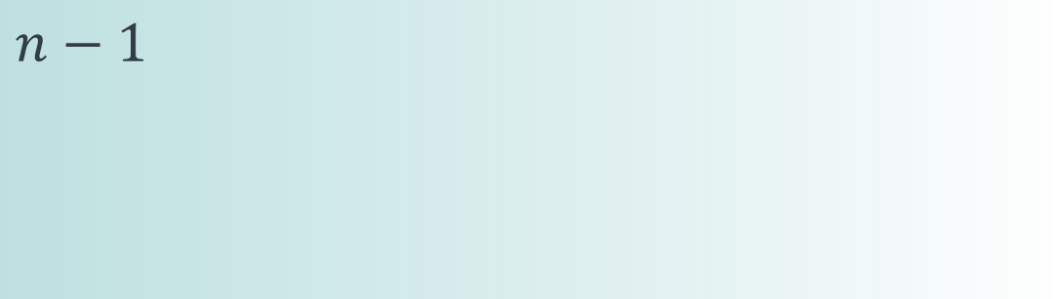
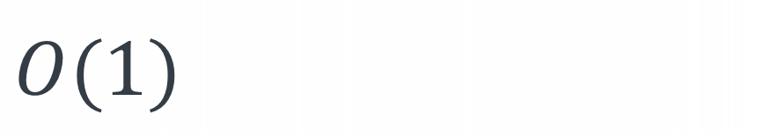
def lis(arr): n = len(arr) dp = [0]*n dp[0] = 1 for i in range(1, n): maxlen = 0 for j in range(i): if arr[j] < arr[i] and dp[j] > maxlen: maxlen = dp[j] dp[i] = 1+maxlen return max(dp)
$$n−1$$
$$i$$
$$O(1)$$

Slide 96
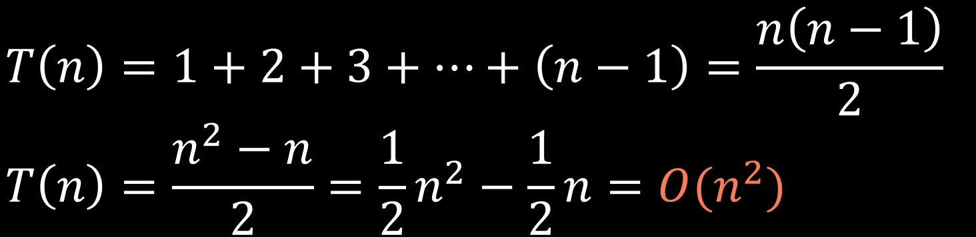
def lis(arr): n = len(arr) dp = [0]*n dp[0] = 1 for i in range(1, n): maxlen = 0 for j in range(i): if arr[j] < arr[i] and dp[j] > maxlen: maxlen = dp[j] dp[i] = 1+maxlen return max(dp)
$$n−1$$
$$i$$
$$O(1)$$
$$T\left(n\right)=1+2+3+…+\left(n−1\right)=\frac{n\left(n−1\right)}{2} \\ T\left(n\right)=\frac{n^{2}−n}{2}=\frac{1}{2}n^{2}−\frac{1}{2}n=O(n^{2})$$

Slide 97

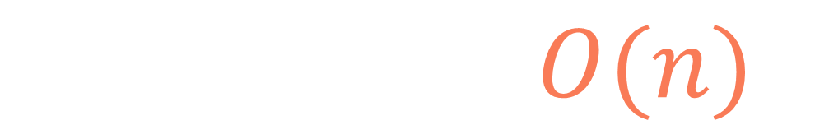
def lis(arr): n = len(arr) dp = [0]*n dp[0] = 1 for i in range(1, n): maxlen = 0 for j in range(i): if arr[j] < arr[i] and dp[j] > maxlen: maxlen = dp[j] dp[i] = 1+maxlen return max(dp)
$$n$$
$$S\left(n\right)=n=O(n)$$

Slide 98
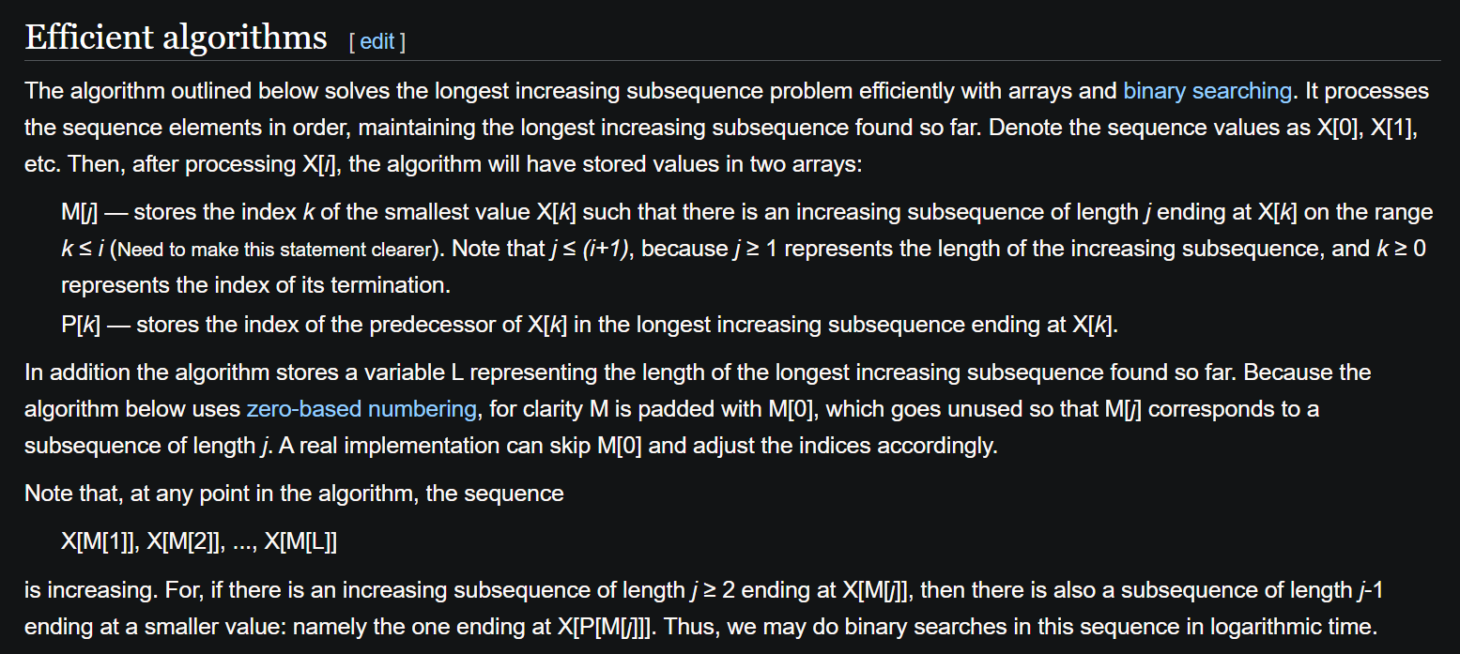

Slide 99
Longest increasing subsequence

